Slide 1
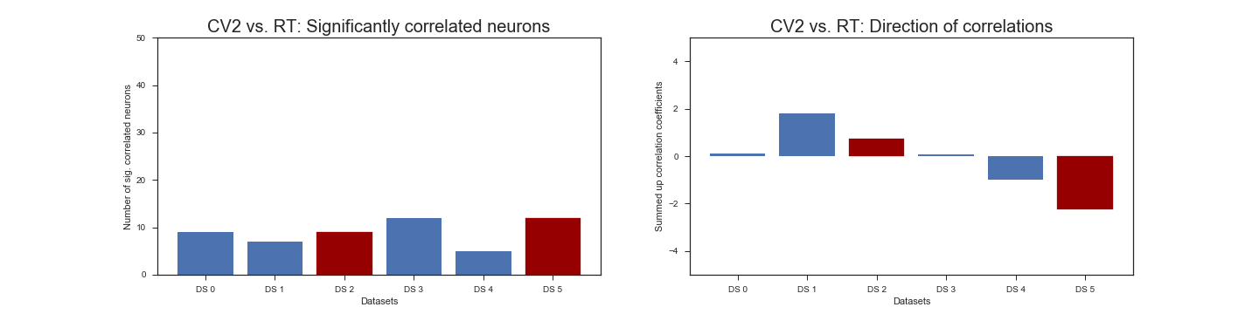
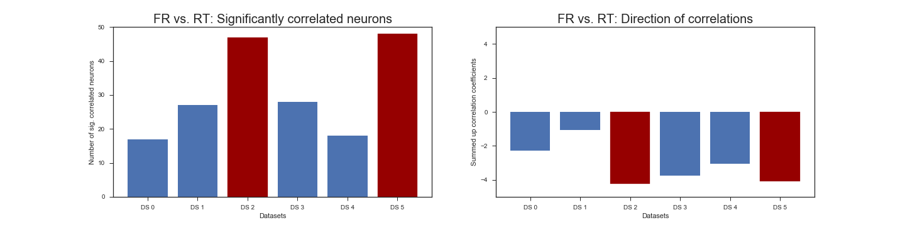

Slide 2
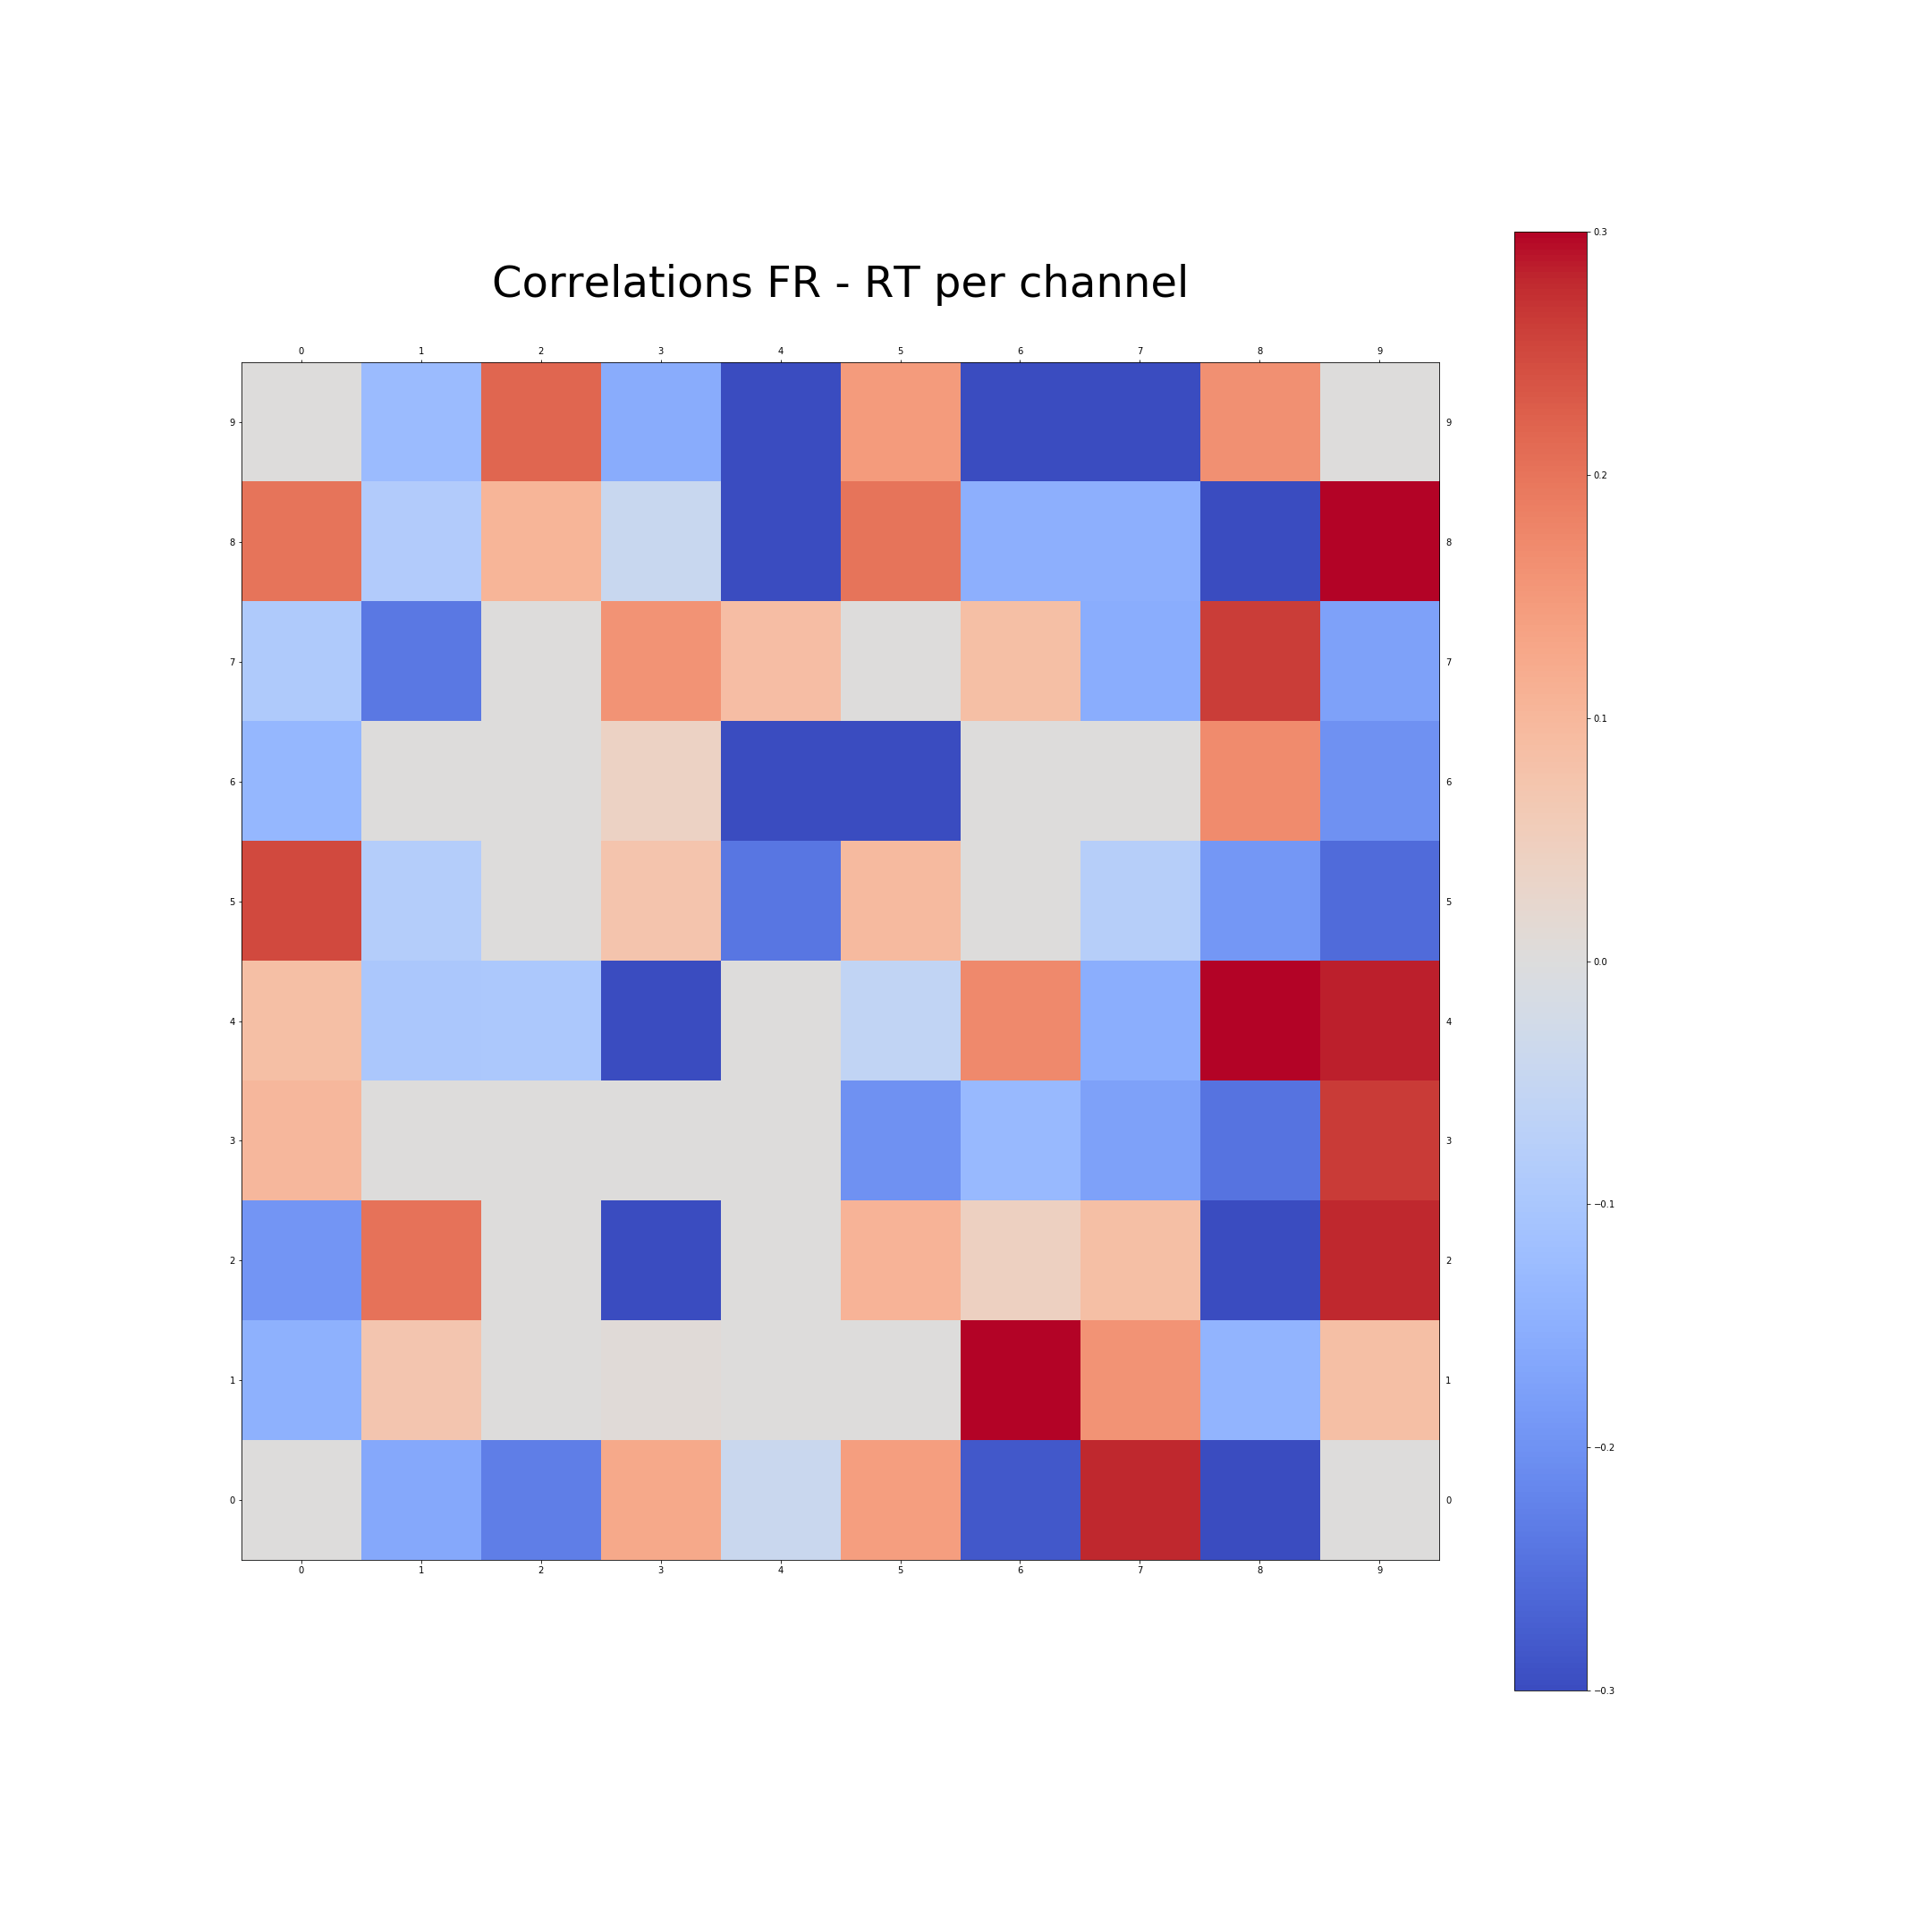

Slide 3
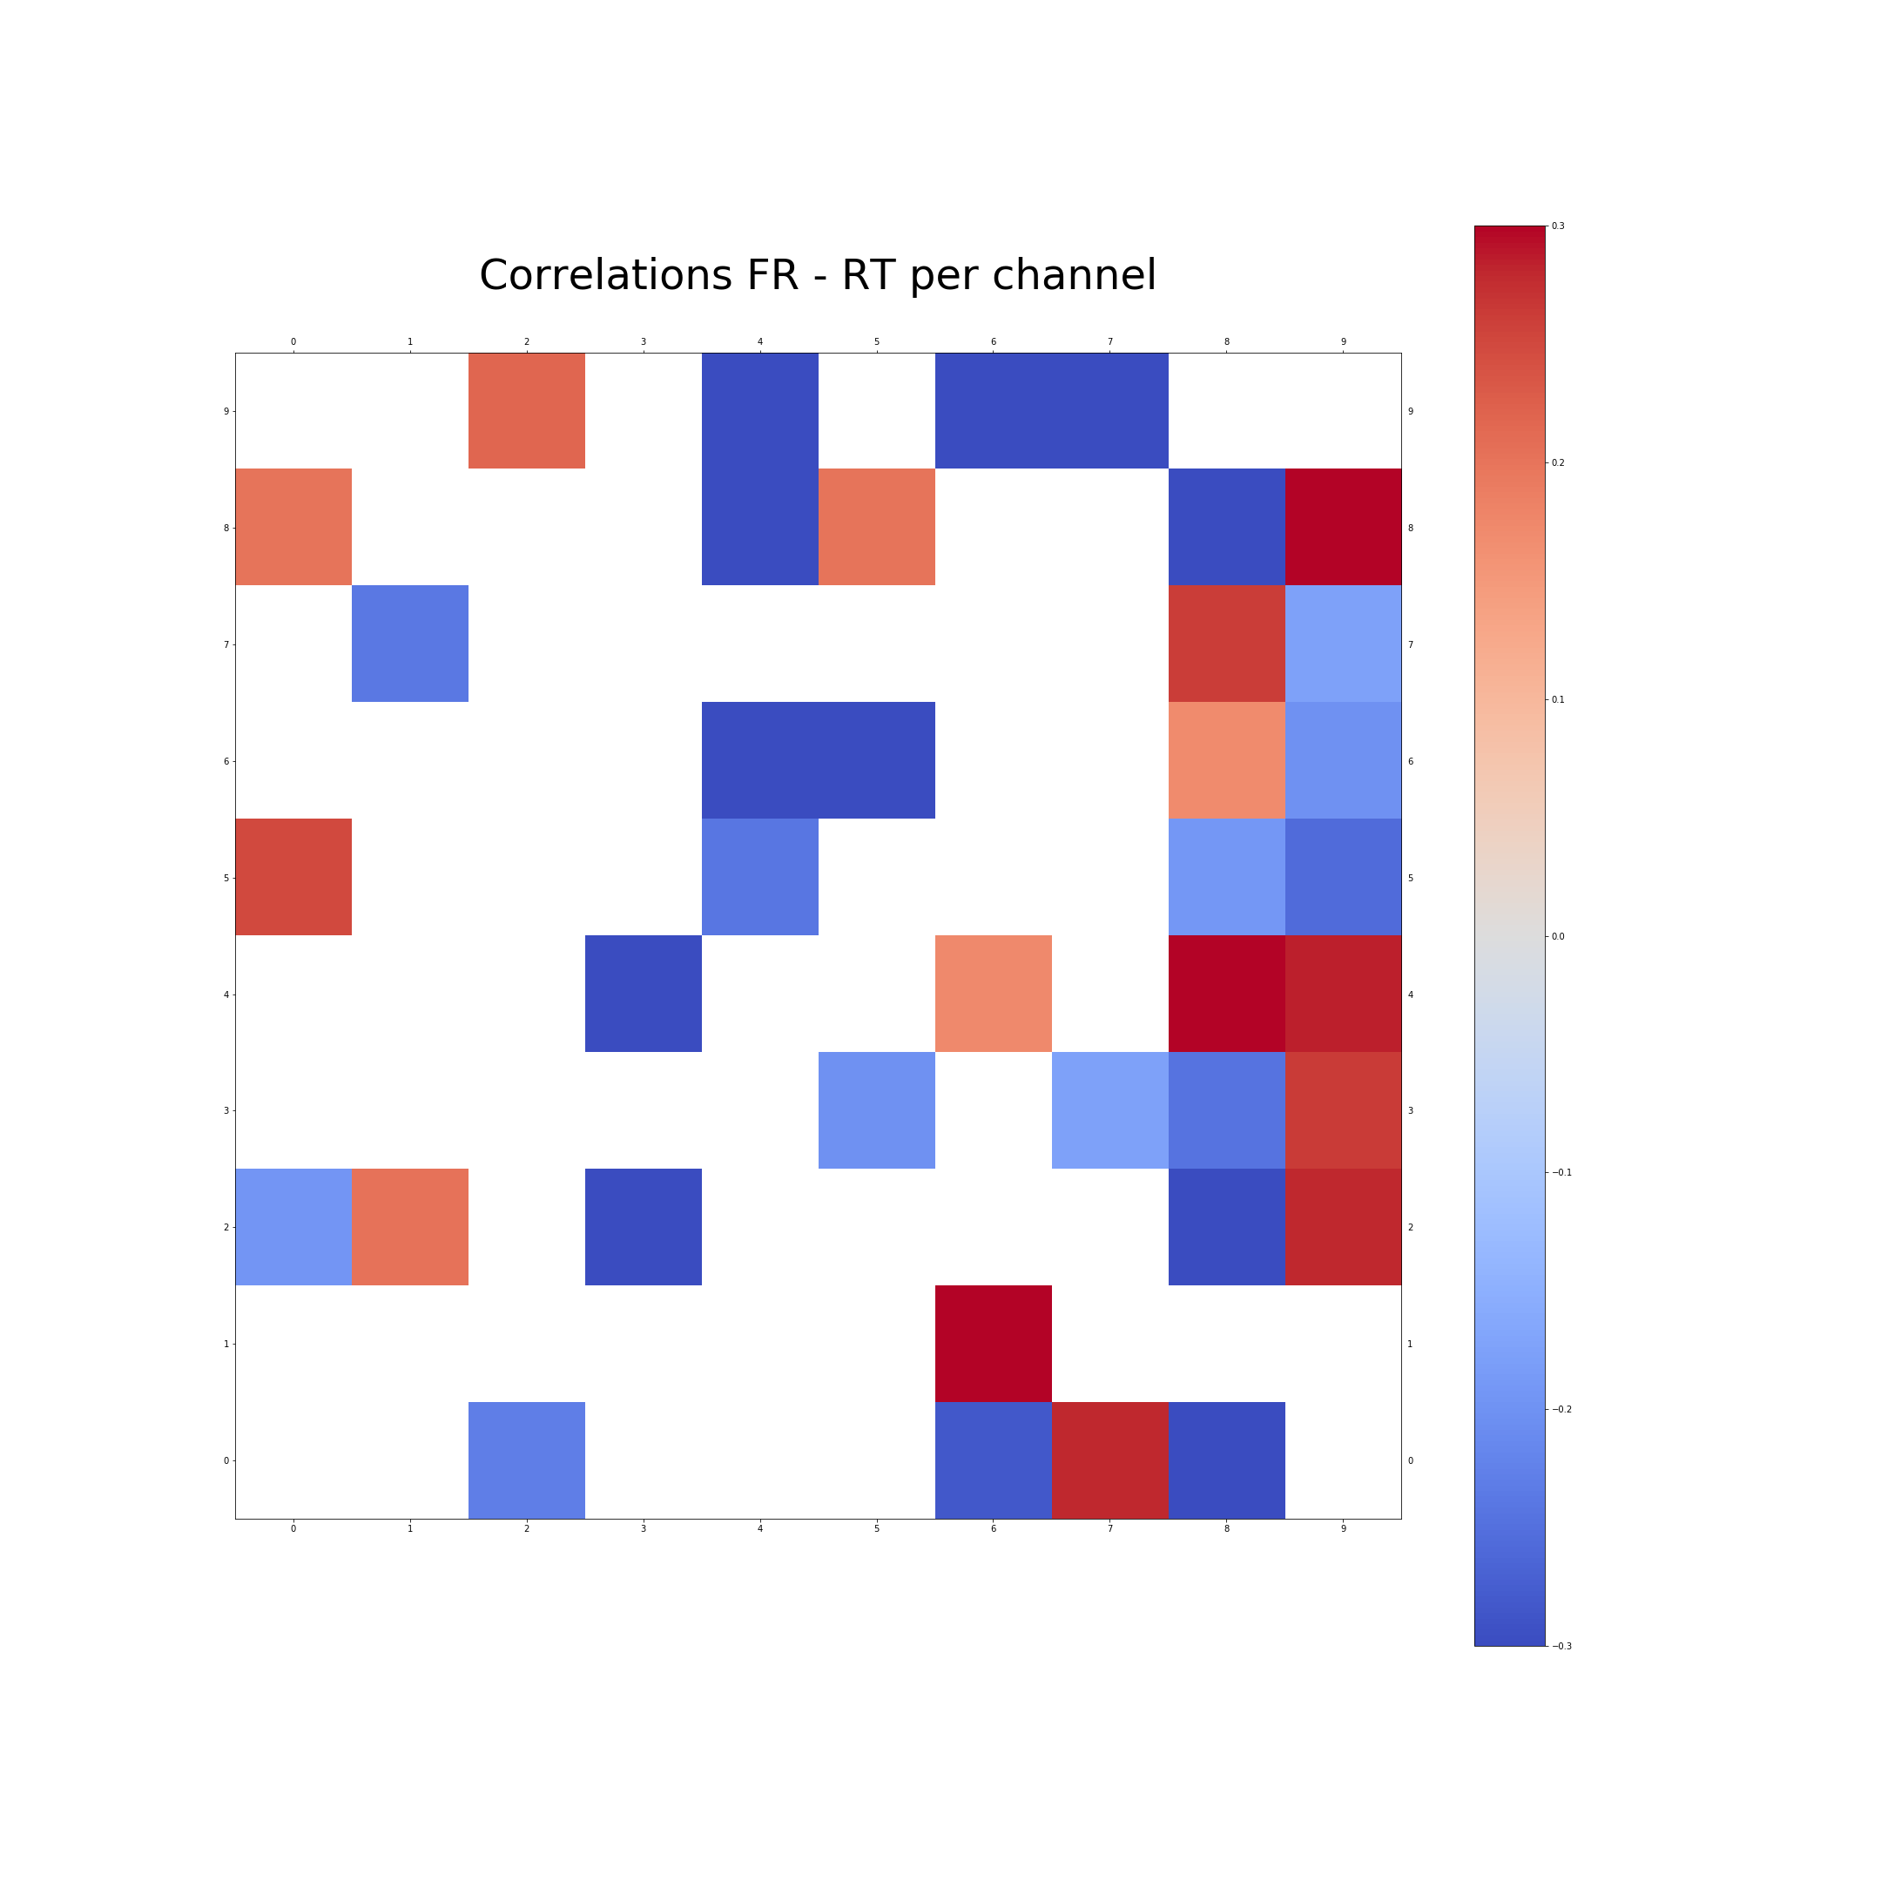

Slide 4
Outline
Part 1: Old shit
How did we find the real dataset?
Slide 1: one pieve of evidence in each corner
Slide 2: ISI nail in the coffin
Part 2: New data!
Jens: Correlations FR-RT across channels
Jahan: Correlations between units across channels
Lungsi: Adding time-resolution with pairwise cross-correlations on a subset of pairs, show eg. 3 pairs in different colors -> 3 cross-corr curves
HP: Fancy PCA movie
Part 3: Conclusions ??

